Slide 1

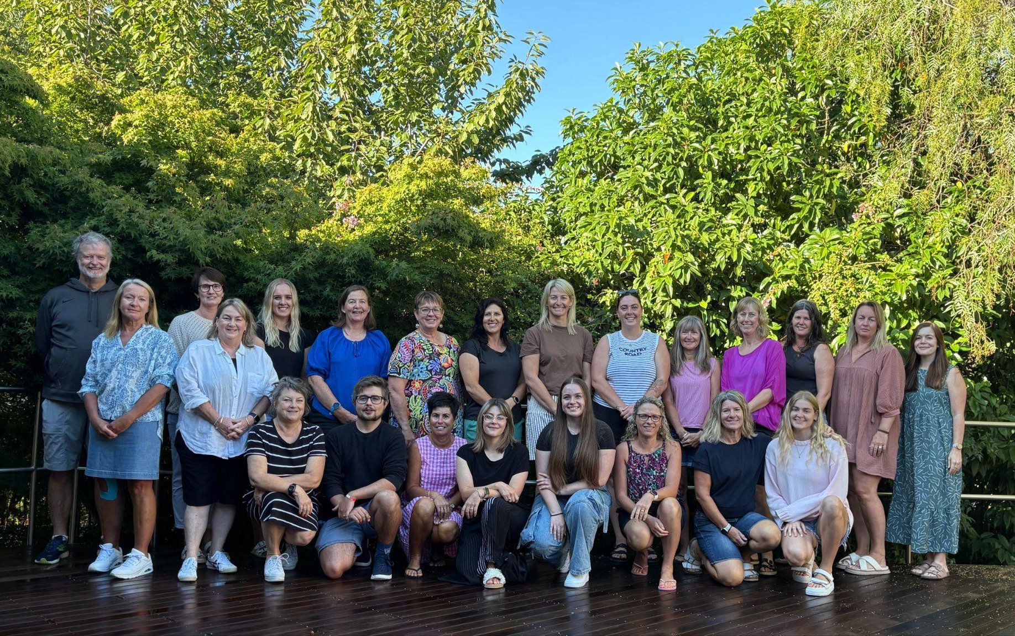
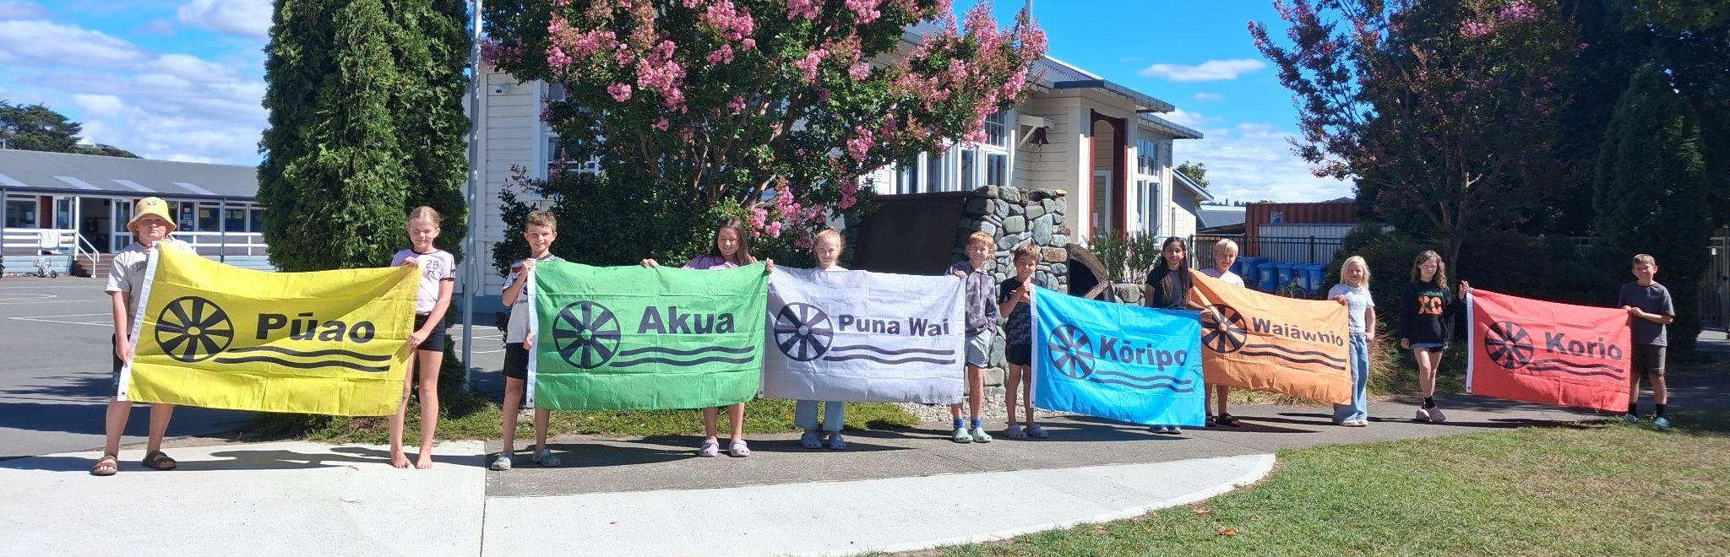
School Newsletter
Week 6, Term 1 2026
Staffing Update
Petra Matz has been appointed as a permanent staff member - she will continue to teach in Room 6 this year.
Corriena Price has been appointed as a fixed term teacher in Room 7 while Paula is on leave.
Stacey Lewis is moving from Southland to teach until the end of 2026 in Room 2.
Updates
Goal Setting Conferences
It was great to see so many parents at school yesterday for the goal setting conferences.
There is a further opportunity tomorrow. Thursday 12 March. This is an opportunity to share learning and social goals with your child and their teacher.
Please contact us at school to make a booking if you are having any issues.
Our Whānau Group Leaders for 2026
Kia Ora Koutou
Congratulations to the following students who received a certificate in our last learning celebration - we celebrate our students who display our values of respect, connect, belong and resilience:
Holly Sixtus, Isabella Beloe, Branson Wilkes, Olive Huxford, Quinn Woolley, Gussy Walsh, Connar McMurtrie, Nora Frost, Blaire Hosie, Elliot Crundwell, Geneva Luamanu, Haru Kagoshima, Jonny Palmer, Ashleen Ghuman, Mila Rosanowski, Beau Smith, Wiremu Waitere, Asher Hoult
Our next Learning Celebration is on Friday 13 March at 2.25pm
The Ministry of Education has provided all schools with 2 teacher only days during the year to continue with Maths Professional Learning and Development in relation to the new curriculum.
Our first day for this year is Friday 15 May - school will closed on this date. This date is required due to facilitator availability.
PB4L - Our Expectations
Thank you for your support with our expectations for students; riding our bikes in full loops of the bike track (in an anti-clockwise direction), and wearing a hat when we are outside.
For the next fortnight, our focus turns to: move quietly around the school, and taking turns.

Slide 2


Thank you to everyone for your efforts so far in selling these tickets. We still have more tickets available. This is a great fundraiser for our school. A special thank you to Anna and Nathan from the Four Square for their efforts and support. All proceeds go towards supporting school events - Aquatic Centre Swimming, Dance tuition, other trips.
All tickets (sold or not) must be back at school, with the money, by Monday 23 March.
Hero - Communication App
Information has been sent out to download our new
Hero app - we are confident that this will be a more
effective communication tool and (over time) replace
the many different ways you receive information.
If you, or another adult in your whānau, are not receiving updates then we may not have your correct email address - please get in touch so we can update our contact information for you.
Please follow this instructions in the link below to download the app or reach out to Aimee or Glenda at school for help.
Instructions and Step by Step guide here

Slide 3


Friday Juicie / Moosie
After school on Friday each week - $2 each.
Proceeds with go towards supporting trips and outside school
activities. Helpers and support would be appreciated.
Parking at Pick Up Time:
When parking to collect your children, please park in correct places (not over driveways). This is to ensure there is no disruption to the public at busy times.
Also - the gate into the school must be kept clear at ALL TIMES.
Road Safety
If your children walk, scooter or bike between home and school, please talk to them about road safety and crossing roads. It has been brought to our attention that there have been some near misses recently when children are crossing Starveall St and Lord Rutherford Road before and after school. Another dangerous area is when crossing the forecourt of NPD. Electric scooters can be particularly problematic given the speeds they can go.
Our school policy states that children must be 10 years of age before riding their bikes on the road unsupervised.
SUBWAY LUNCHES – ONLINE
How easy is this??? – You can now logon to subway.co.nz/schools and order Monday subway lunches and they will be delivered to school. These can be ordered at any time during the week with a close off time of 9am on Monday morning. Here is how to do it:
On your PC or laptop go to:
subway.co.nz/schools
Subway express
School lunch programme
Register – takes a few minutes – but only has to be done once – next time ordering will be very simple
Make your order by clicking through the selections and pages
We’re happy for school parents and caregivers to use the premises for pick-ups / drop-offs.
Parking is only permitted if vehicles reverse in along the fence line for the safety of the children and if the driveway is full, they’re welcome to park at the rear of the workshop.
Please be mindful of neighbouring driveways and ensure all workshop entrances remain clear at all times.
All parking is at owner’s risk.

Slide 4
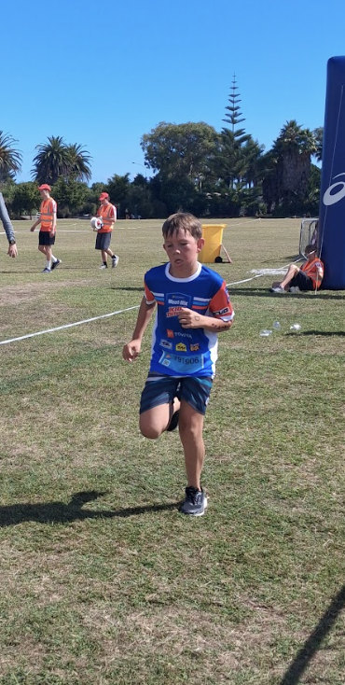
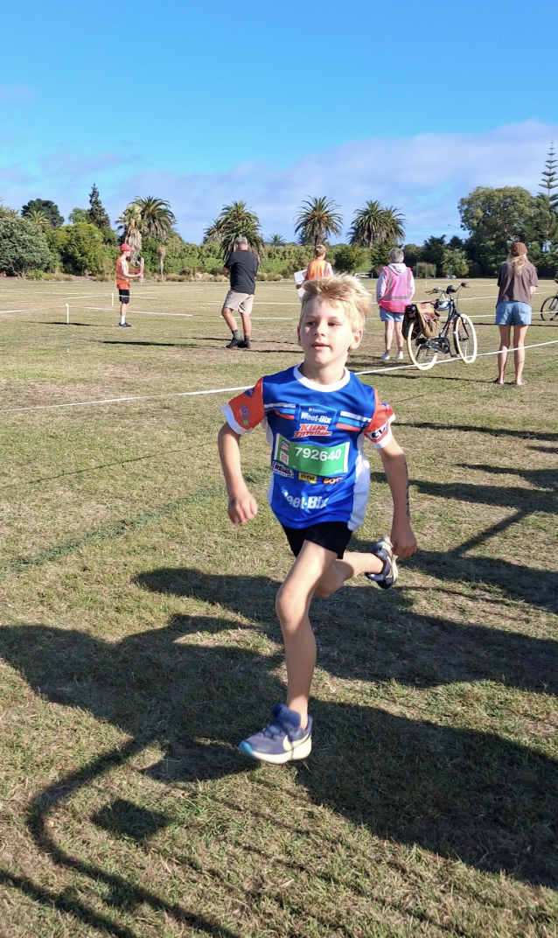
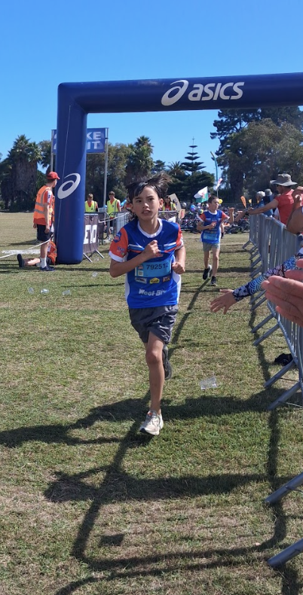
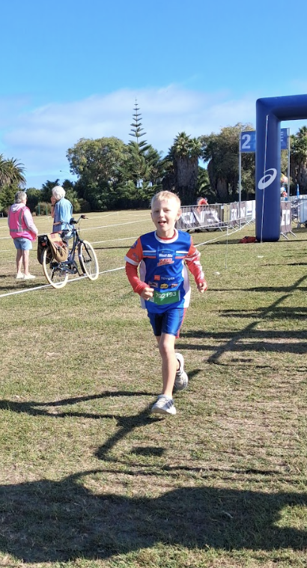
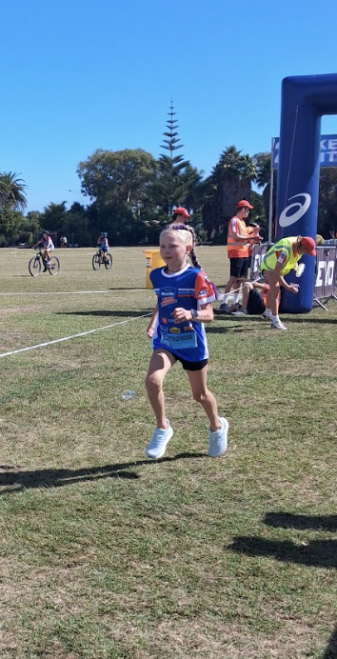
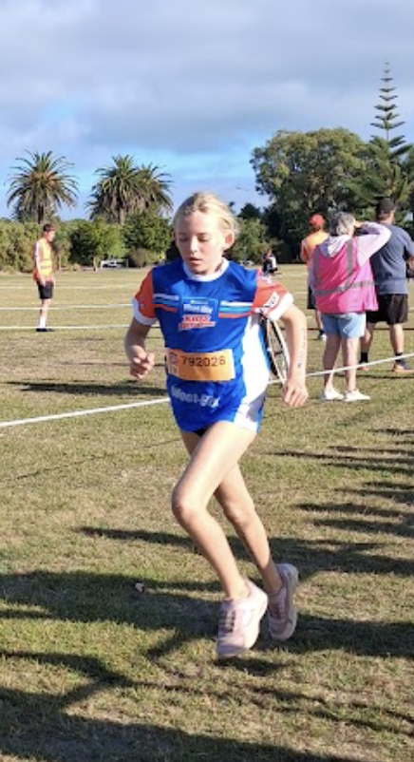
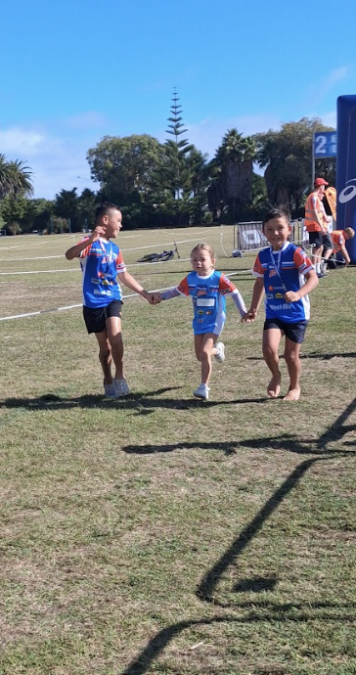
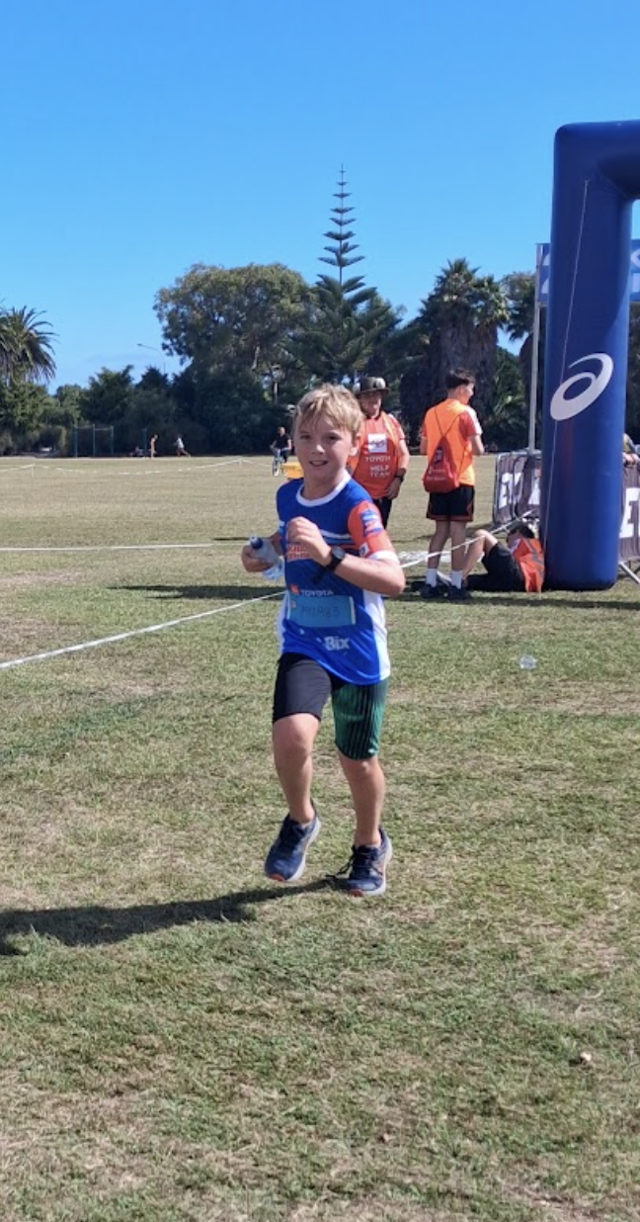
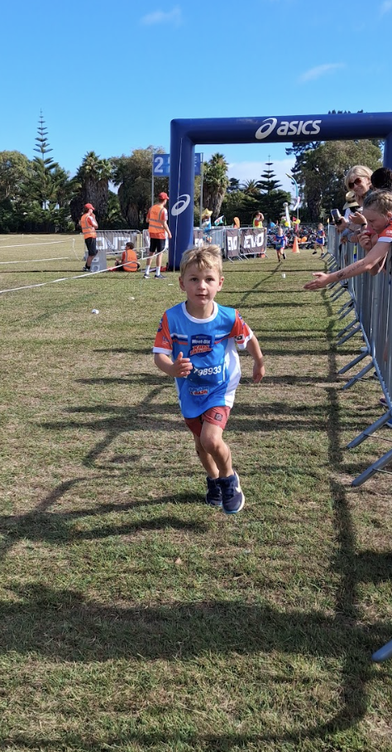
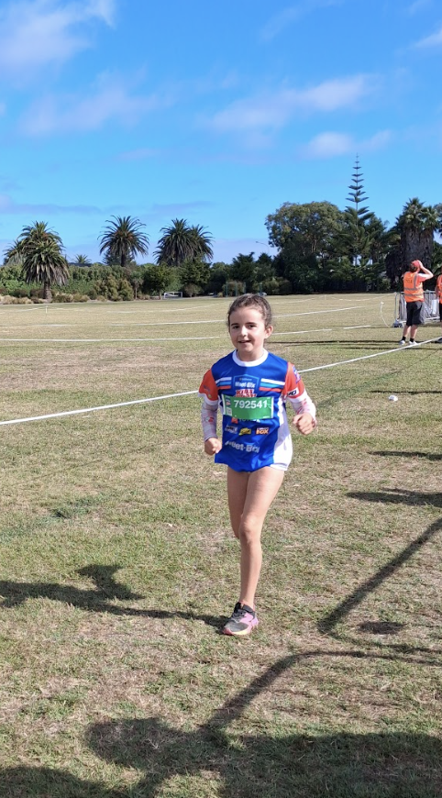

Whole School Tryathlon and Weet-bix Kids Tryathlon
Congratulations to everyone for a great effort at our school Tryathlon and Splash and Dash on Friday. It was great to see everyone participating and giving it a go. Well done to all of those who then completed the Weetbix Tryathlon on Sunday. Your sportsmanship and effort is to be proud of!
Thank you to the staff for supporting these events.
Lunchbox Tips and Tricks

Slide 5
Upcoming Events - This Term
Event | Date | Detail
Hockey in School Sessions | Week 6 and 7 | An opportunity for classes to develop hockey skills with outside instructors
Volleyball in School Sessions | Week 7 | An opportunity for classes to develop volleyball skills with outside instructors
Goal Setting Conferences | 10 and 12 March from 2pm | An opportunity to meet with your child’s teacher and generate social and learning goals for the year ahead
Interschool Swimming Sports | Thursday 12 March | Selected students Wakefield School
Senior Leadership Training Day | Thursday 19 March | Senior students leadership training with Nick from Sport Tasman
Fire Evacuation Drill | Tuesday 24 March | Time TBC - opportunity to practice our processes in the event of a fire at school
Last Day of Term 1 | Thursday 2 April | Friday 3 April - Good Friday
Upcoming Events - Term Two
Event | Date | Detail
First Day of Term 2 | Monday 20 April | Term 2 Begins
ANZAC Day observed | Monday 27 April | Public Holiday
Staff Only Day | Friday 15 May | School Closed for Instruction
Aquatic Centre Swimming Fortnight | From Monday 18 May | Wai-iti and Wairoa Teams - daily instruction at the Richmond Aquatic Centre
Rippa Tournament | Tuesday 19 May | Selected students Postponement date - Thursday 21 May
King’s Birthday | Monday 1 June | Public Holiday
School Cross Country | Date TBC - possibly Friday 5 June
Cluster Cross Country | Wednesday 10 June | Selected students competing against local schools for place in regional event
Playhouse Theatre | Tuesday 16 June | Stage Show at school

